Slide 1
NEXT WORD PREDICTION USING BI-LSTM
MINI PROJECT - 1
ABHEET KUMAR (19BCS002)
SHIVAM KUMAR SANGAL (19BCS073)
ABHINAV MAURYA (19BCS003)

Slide 2
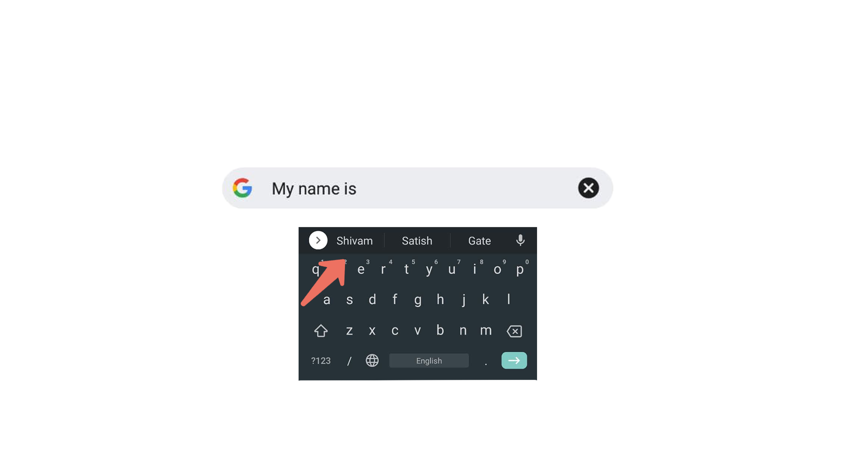
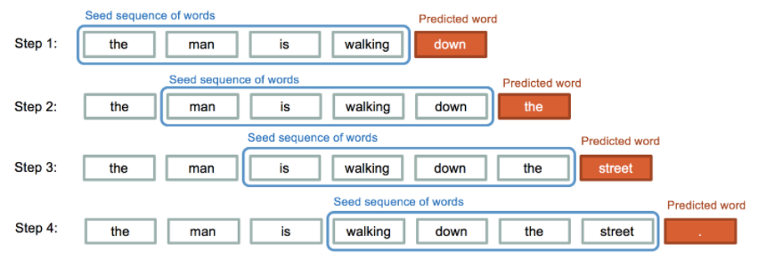
INTRODUCTION
In this Next word prediction project , we try to predict the next character or word of sequence.
We use deep learning models ( BI-LSTM ) for this project. The model will also learn how much similarity is between each word

Slide 3
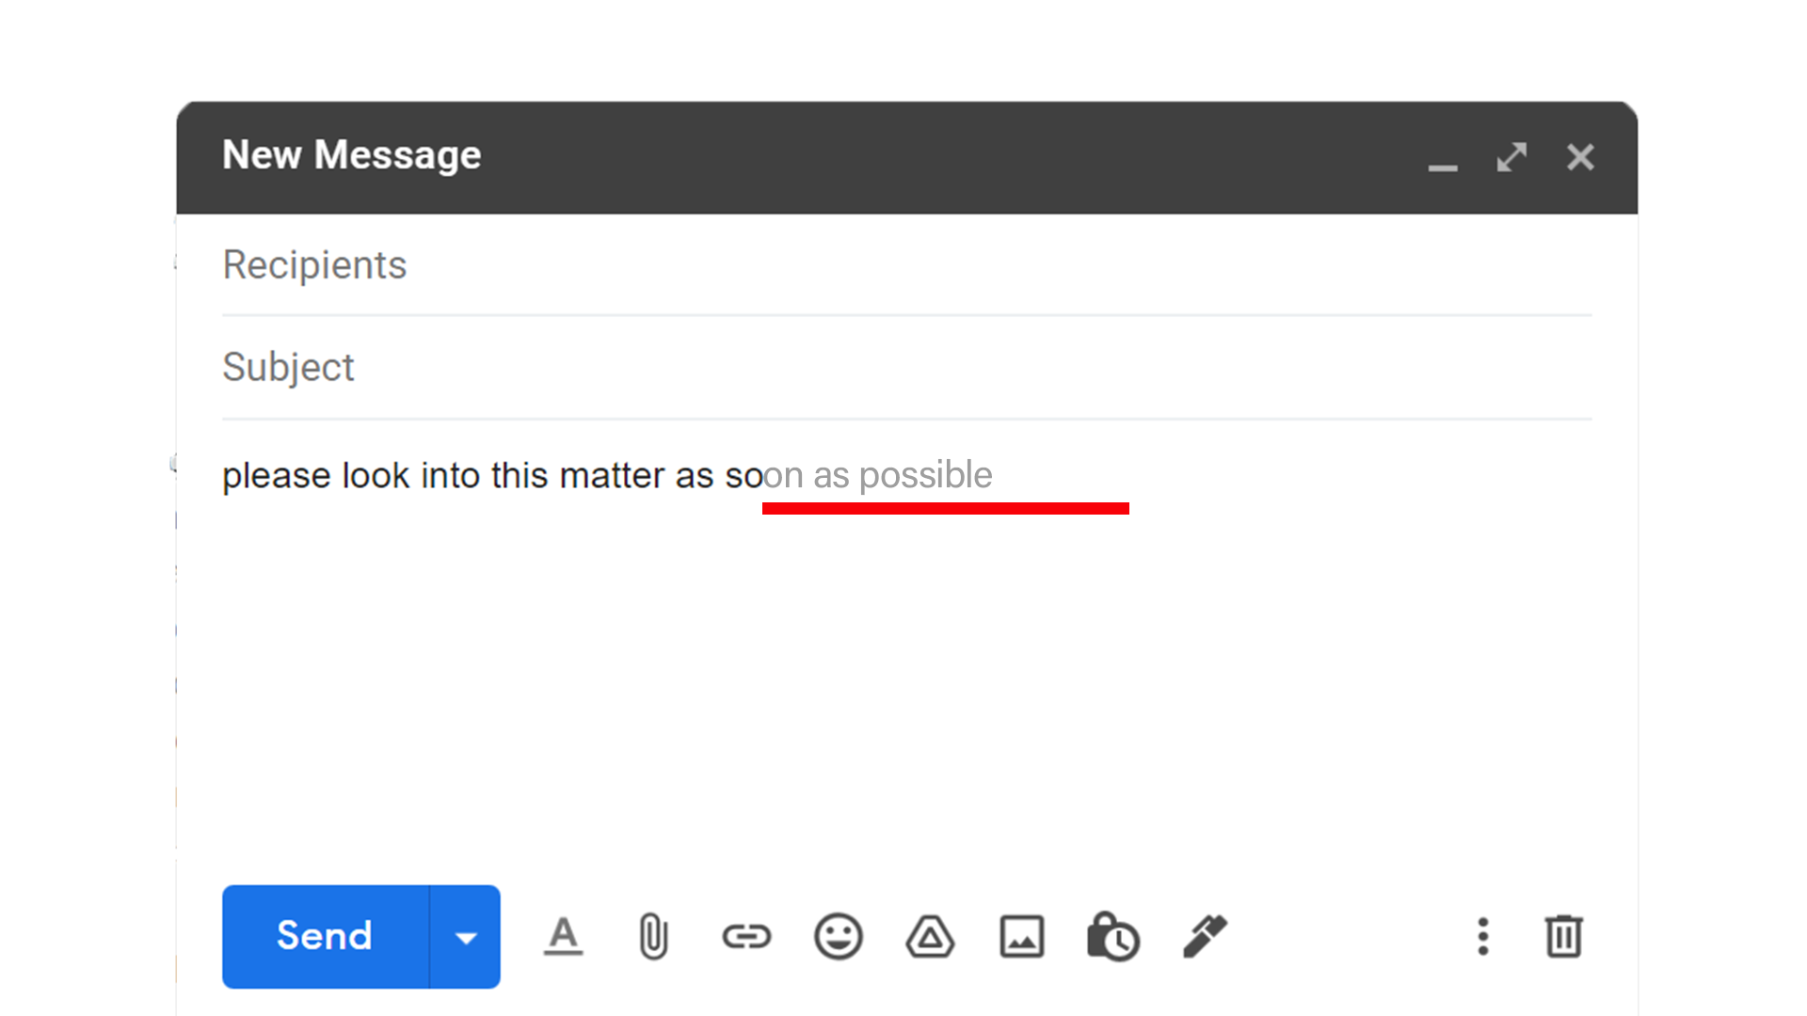
OBJECTIVES
The prime objective of this project is to minimize keystrokes which saves time while typing.

Slide 4

Students who are still working on their language skills can take its help.​​
We can make a system that can generates its own story from scratch by the help of this project

Slide 5
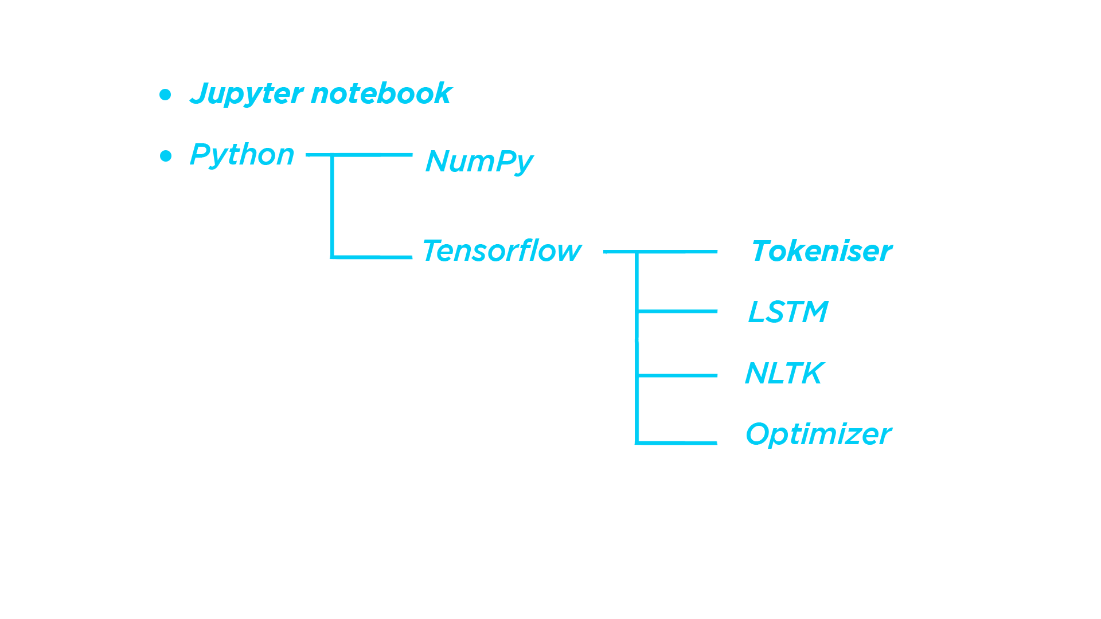
Tools a & Libraries used

Slide 6

Why we use Jupyter notebook ?
1. Documentation and coding together
2. Jupiter notebooks can illustrate the analysis process step by step

Slide 7
Why we use LSTM not RNN ?

Slide 8
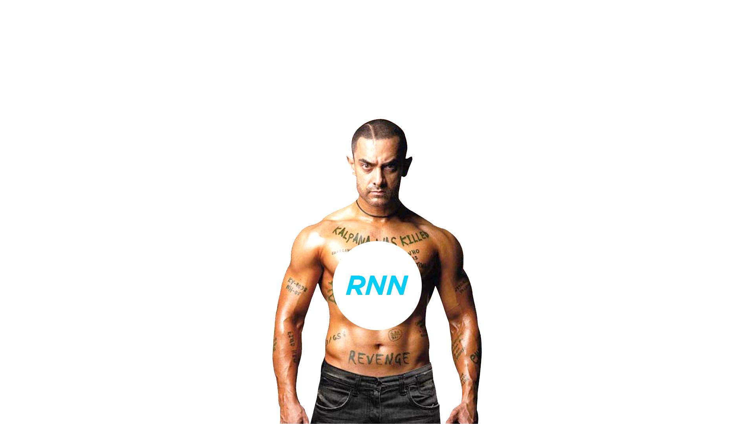
LSTM has advantage over RNN as LSTM can handle the information in memory for the long period of time as compare to RNN
"
LSTM networks are a type of RNN that uses special units in addition to standard units. LSTM units include a 'memory cell' that can maintain information in memory for long periods of time.
Long term memory problem

Slide 9
Backend

Slide 10
LSTM (Long Short Term Memory) :
We use LSTM because the text generation we have to memorize is a large amount of previous data. LSTM used as solutions for short-term memory learning.
LSTM contains a gate which determines the flow of information.
The gates decide which data is important and can be useful in the future and which data has to be erased. The three gates are the input gate, output gate, and forget gate.

Slide 11
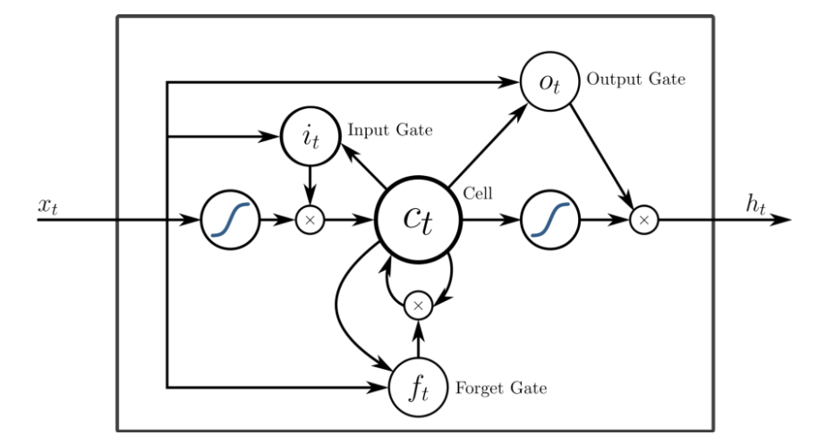

Slide 12
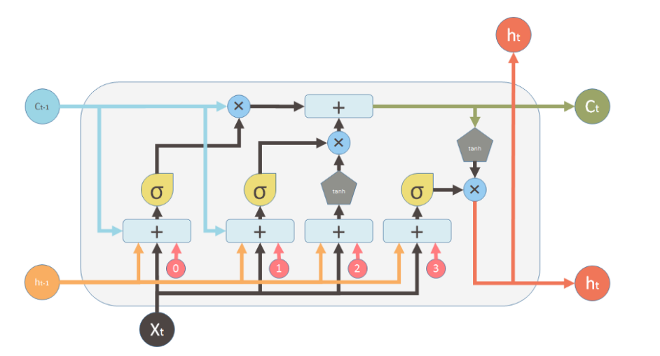
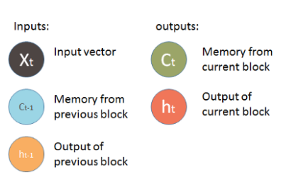
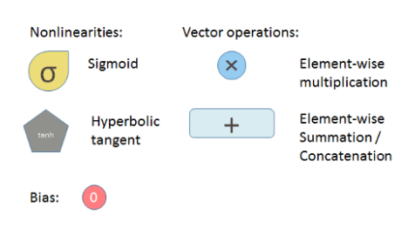

Slide 13
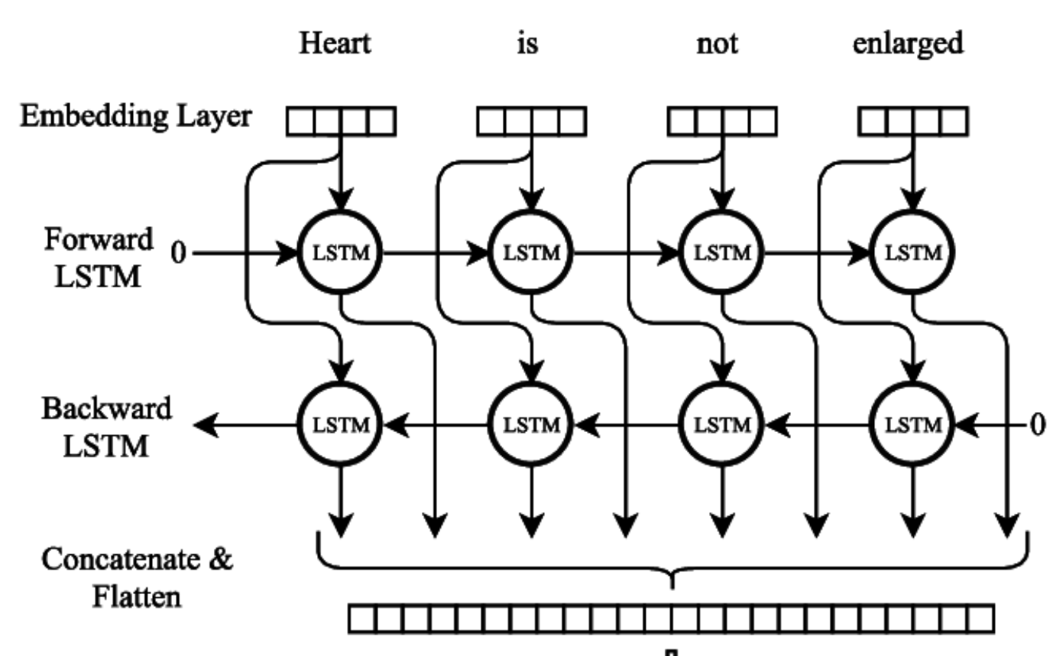
STRUCTURE OF BI-LSTM

Slide 14
WORKFLOW
Load the text data.
Preprocessing.
Tokenization.
Prepare dataset as input and output sets using dictionary.
Define our model and Training the Model.
Predicting the Result using our Model.

Slide 15

WHY TO PREPROCESS OUR TEXT DATA?
TO IMPROVE QUALITY OF DATA.
TO INCREASE EFFICIENCY
REMOVE NOISY, INCONSISTENT AND INCOMPLETE DATA

Slide 16
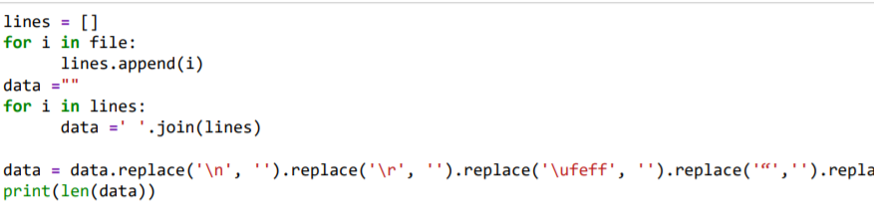
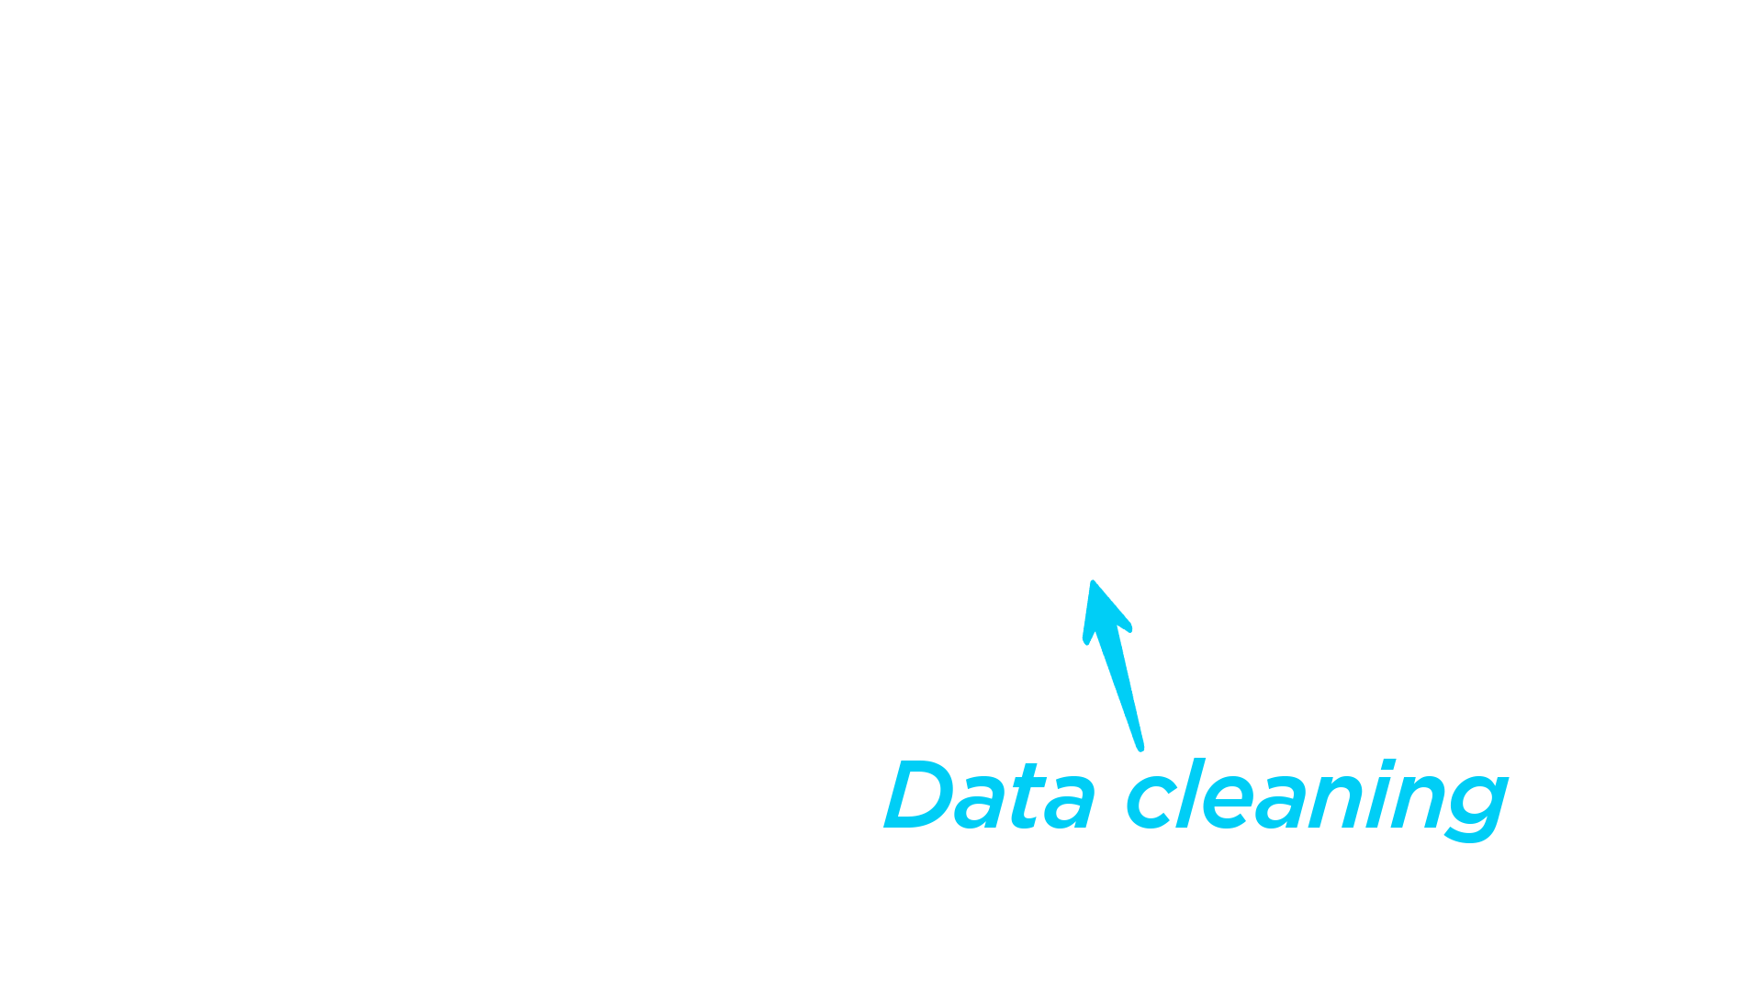
Preprocessing

Slide 17
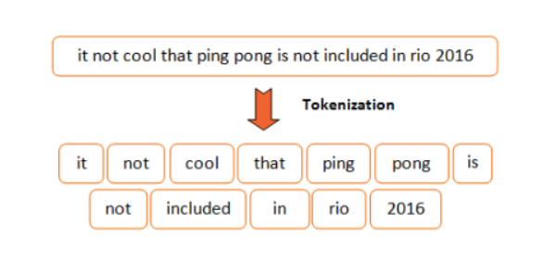
WHAT IS TOKENIZATION?
Tokenization is a way of separating a piece of text into smaller units called tokens. Here, tokens can be either words, characters, or sub words.

Slide 18
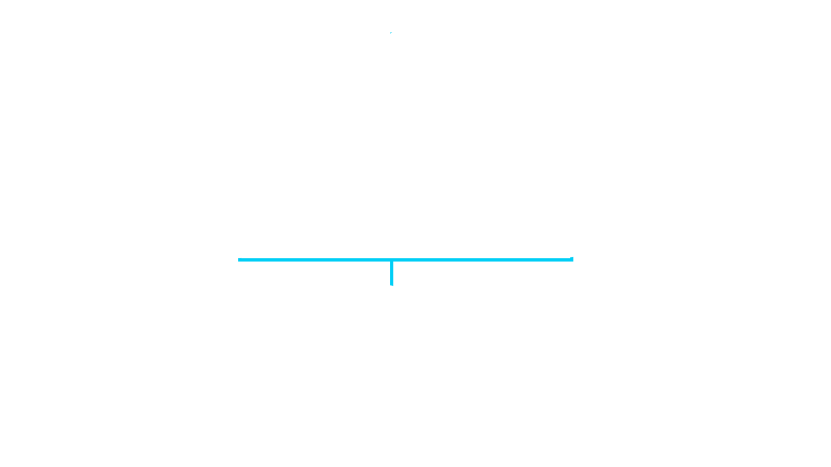
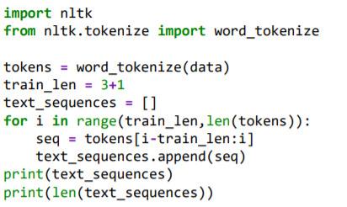
TOKENIZATION
['The', 'Project', 'Gutenberg', 'eBook'],
['Project', 'Gutenberg', 'eBook', 'of']
['Gutenberg', 'eBook', 'of', 'The']

Slide 19
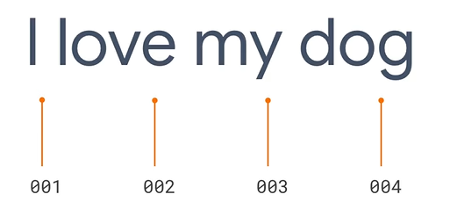
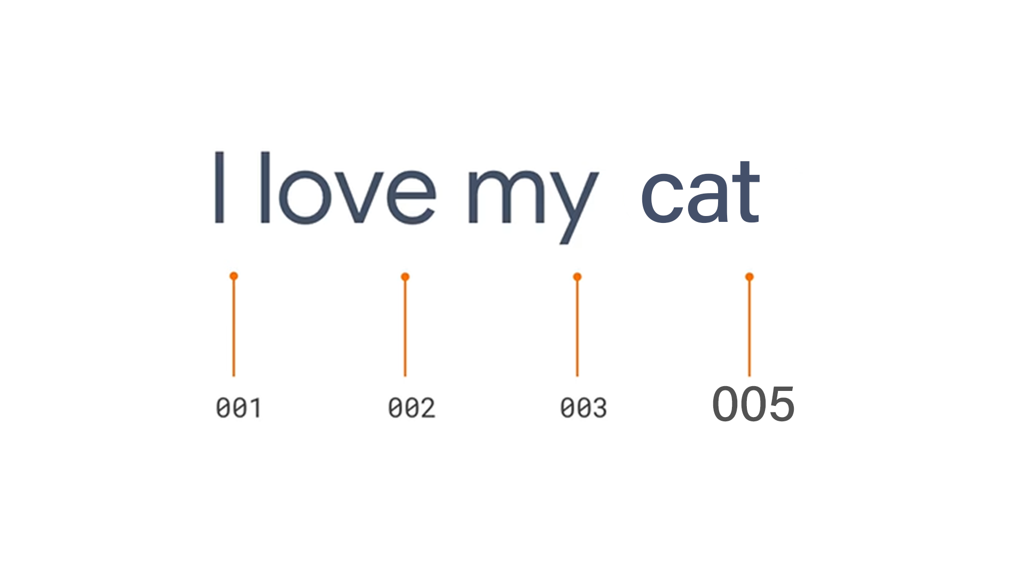
TOKENIZATION

Slide 20
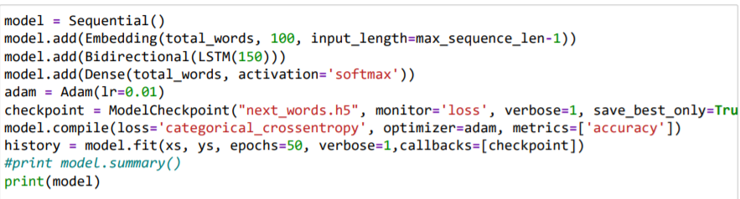
Training part

Slide 21
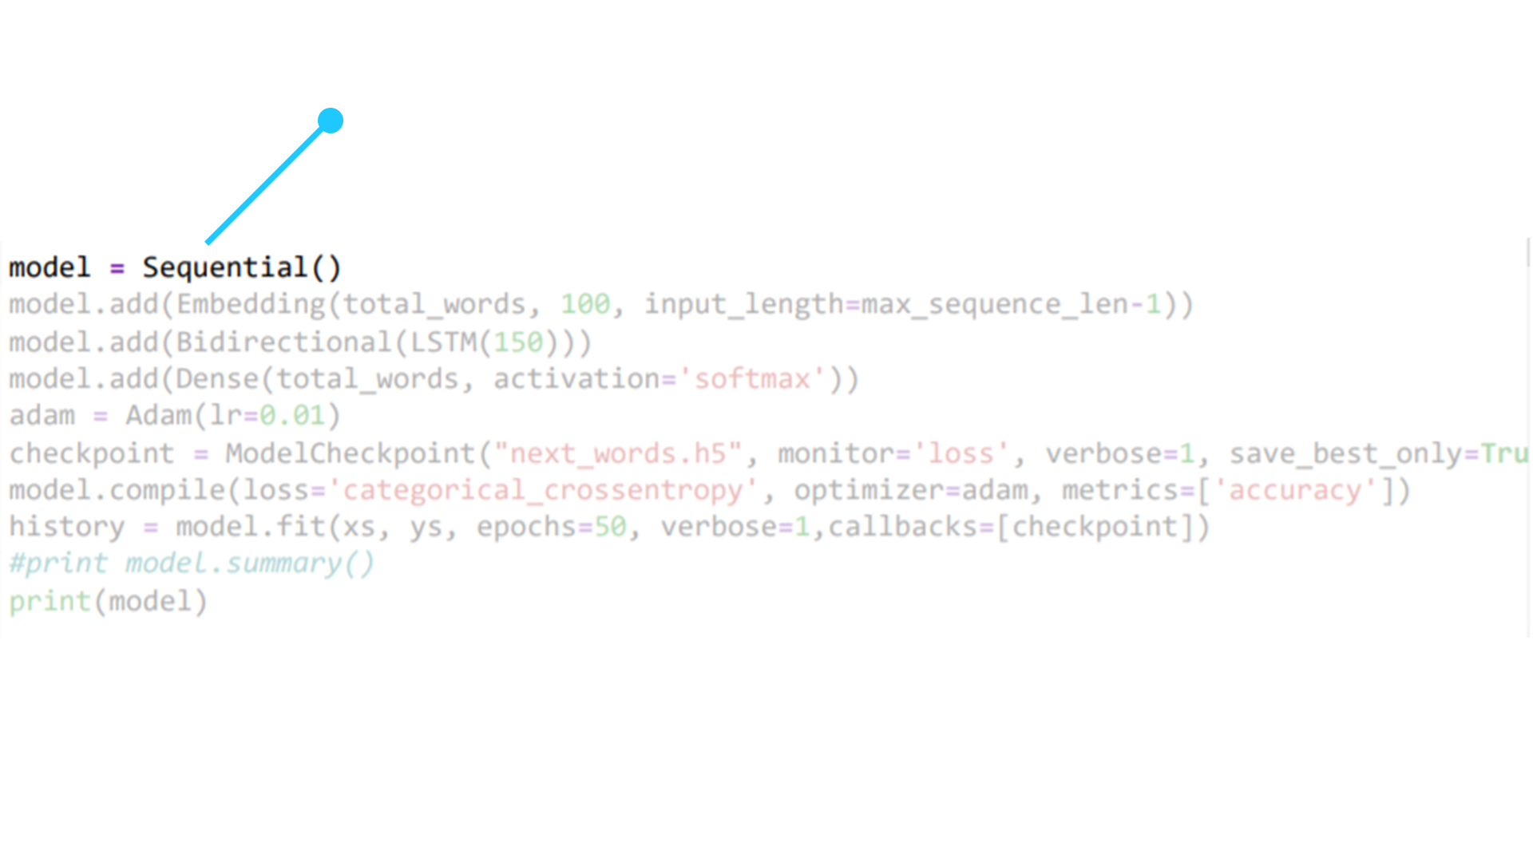
The sequential API allows you to create models layer-by-layer for most problems. It is limited in that it does not allow you to create models that share layers or have multiple inputs or outputs.

Slide 22
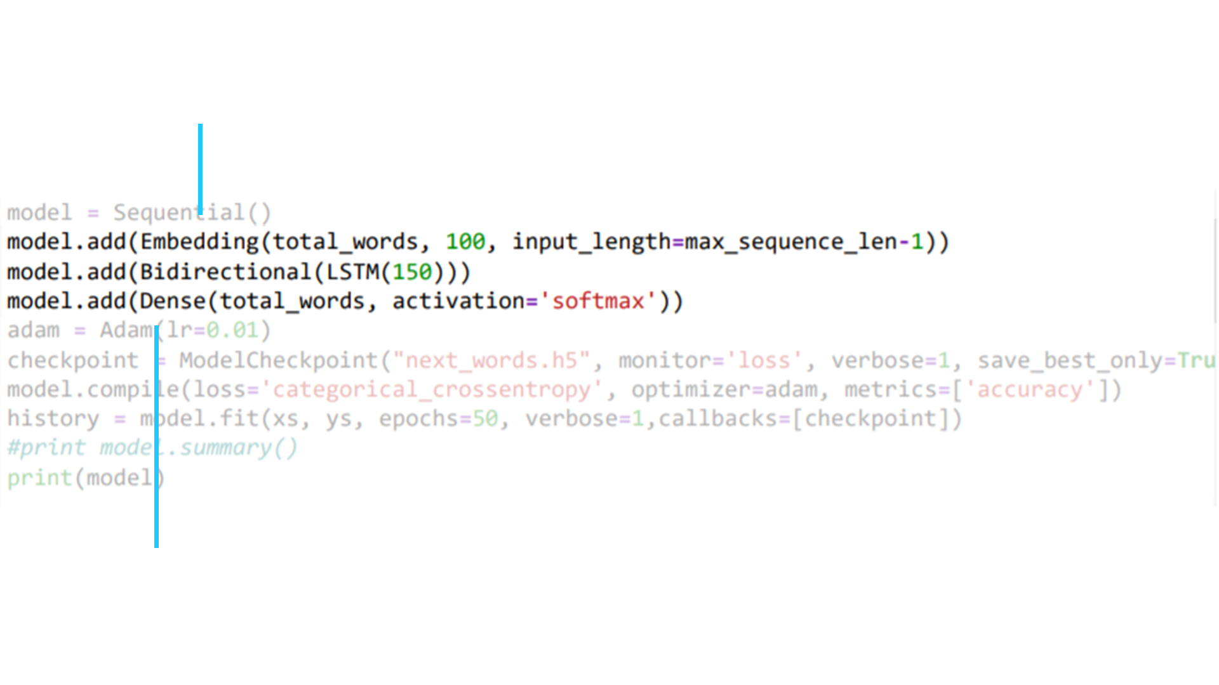
Embedding layer enables us to convert each word into a fixed length vector of defined size.
The dense layer performs the matrix multiplication. The values used in the matrix are actually parameters that can be trained and updated with the help of back propagation

Slide 23
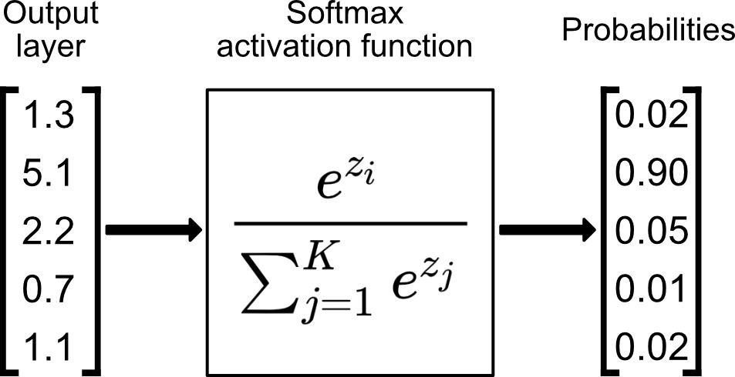
This layer has the activation function Softmax

Slide 24
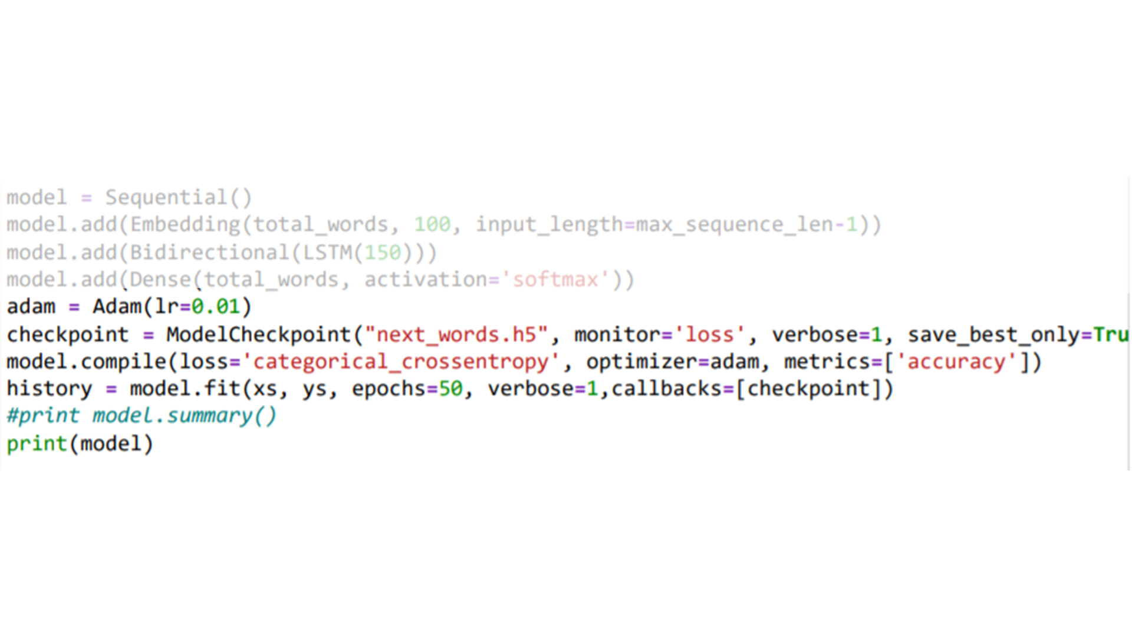
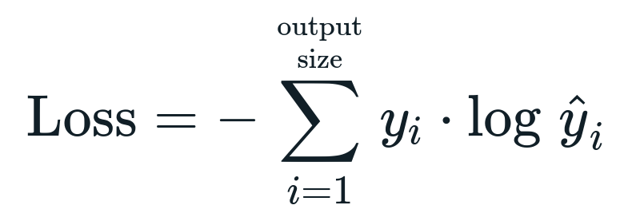
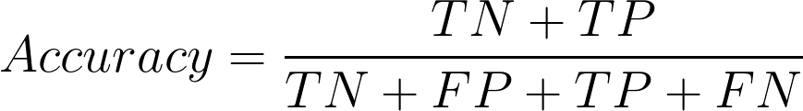
Loss Function
It reduces the distances between the two probability distribution predicted and actual.
Adam Optimizer with learning rate.

Slide 25
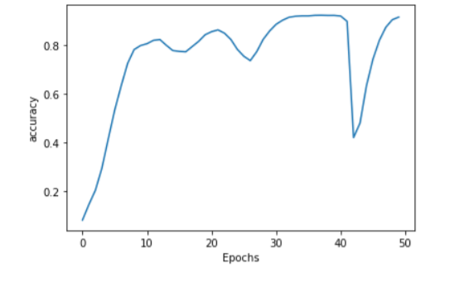
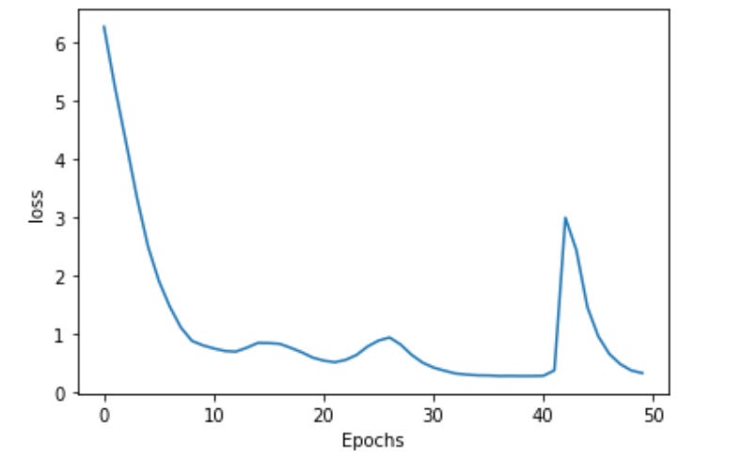
Training part
Accuracy
Loss

Slide 26
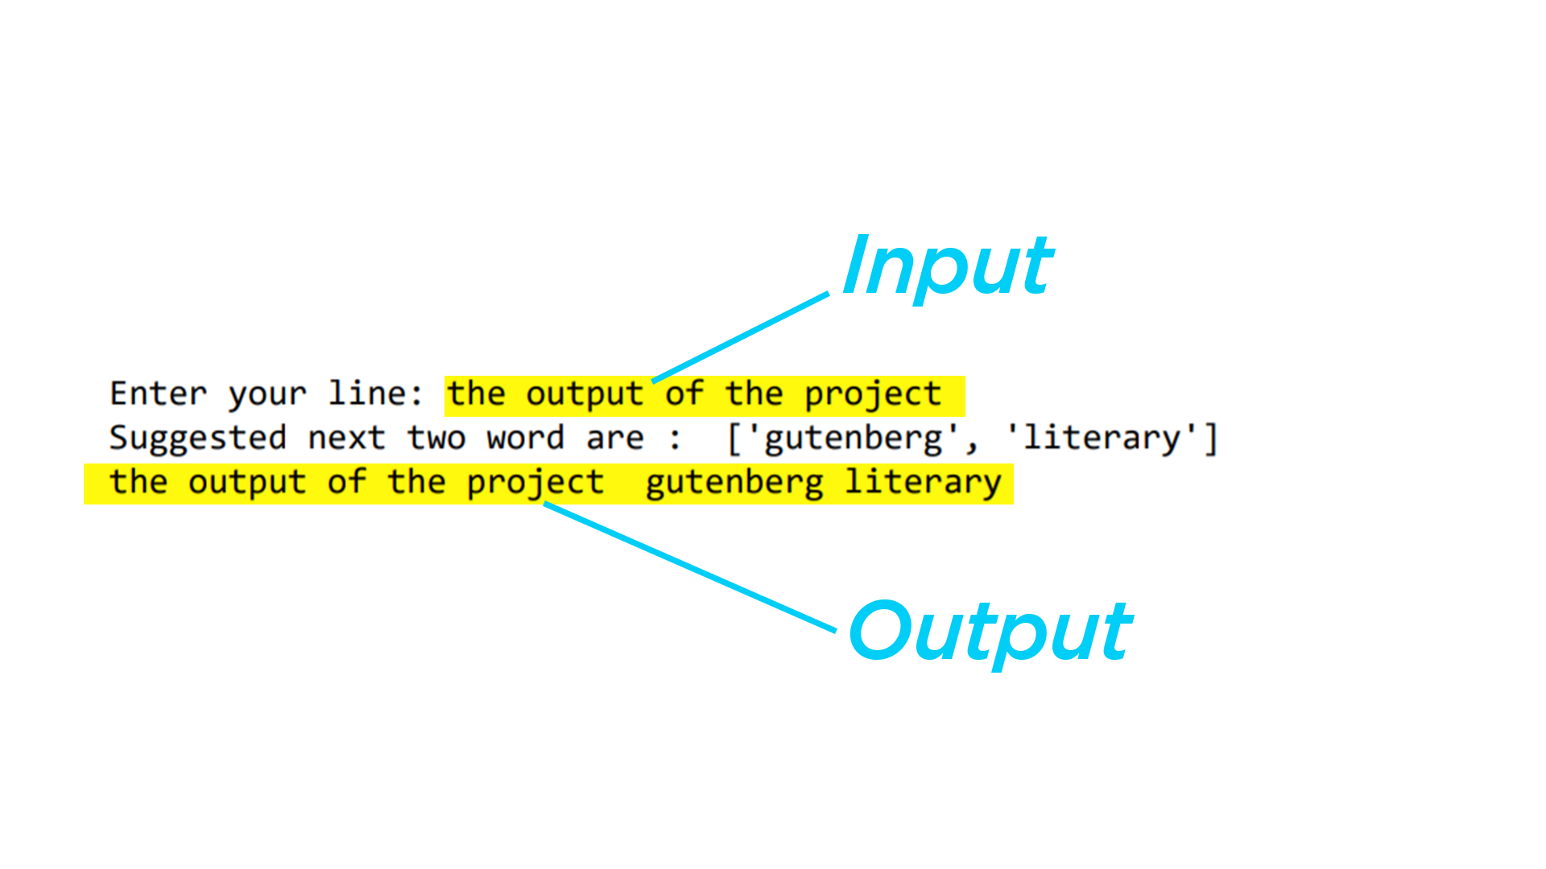
OUTPUT :
Progress till now
Backend :
Frontend :

Slide 27
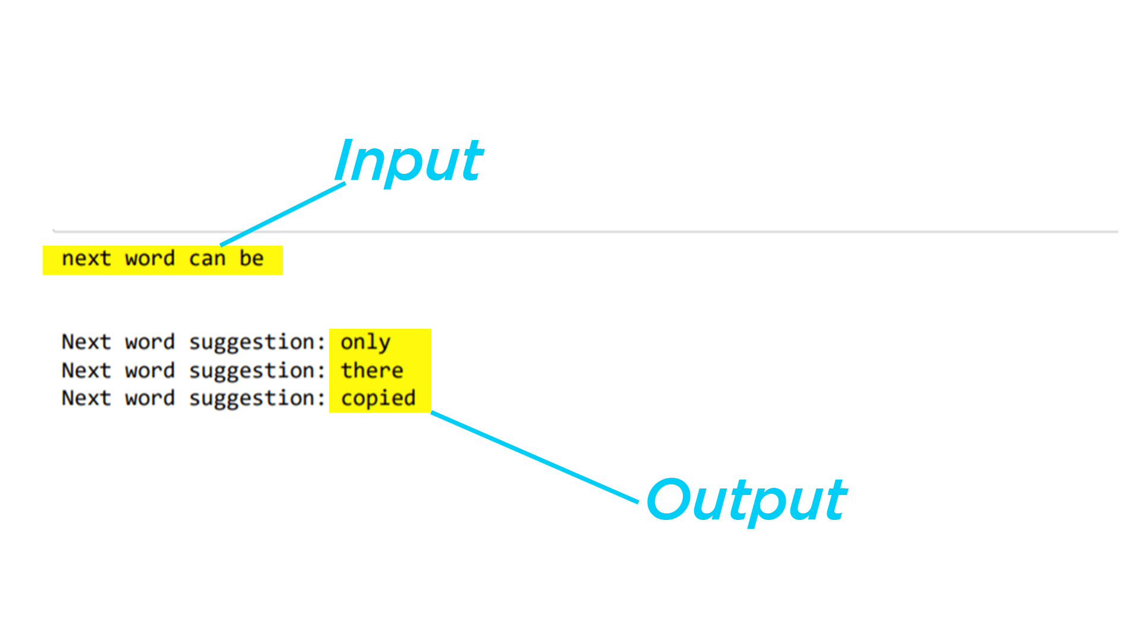
OUTPUT :
Progress till now
Backend :
Frontend :

Slide 28

THE END

